Slide 1

GitHub/Git bash

Slide 2
What is Github?
A provider of Internet hosting for software development and version control.
It offers the distributed version control and source code management (SCM) functionality
It provides access control and several collaboration features such as bug tracking, feature requests, task management, continuous integration and wikis for every project.
It is commonly used to host open-source projects. As of November 2021, GitHub reports having over 73 million developers and more than 200 million repositories. This includes at least 28 million public repositories. It is the largest source code host as of November 2021.

Slide 3
Benefits of Github
It Makes It Easy to Contribute to Your Open Source Projects
Nearly every open-source project uses GitHub to manage their project. Using GitHub is free if your project is open-source, and GitHub includes a wiki and issue tracker that makes it easy to include more in-depth documentation and get feedback about your project.
Documentation
By using GitHub, you make it easier to get excellent documentation. Their help section and guides have articles for nearly any topic related to git that you can think of.
Showcase your work
If you are a developer looking for recruitment GitHub is the best tool you can rely on for this. Today, when searching for new recruits for their project, most companies look into the GitHub profiles. If your profile is available, you will have a higher chance of being recruited even if you are not from a great university or college.
Markdown
Markdown allows you to use a simple text editor to write formatted documents. GitHub has revolutionized writing by channeling everything through Markdown: the issue tracker, user comments, everything. With so many other programming languages to learn for setting up projects, it’s really a big benefit to have your content inputted in a format without having to learn yet another system.

Slide 4
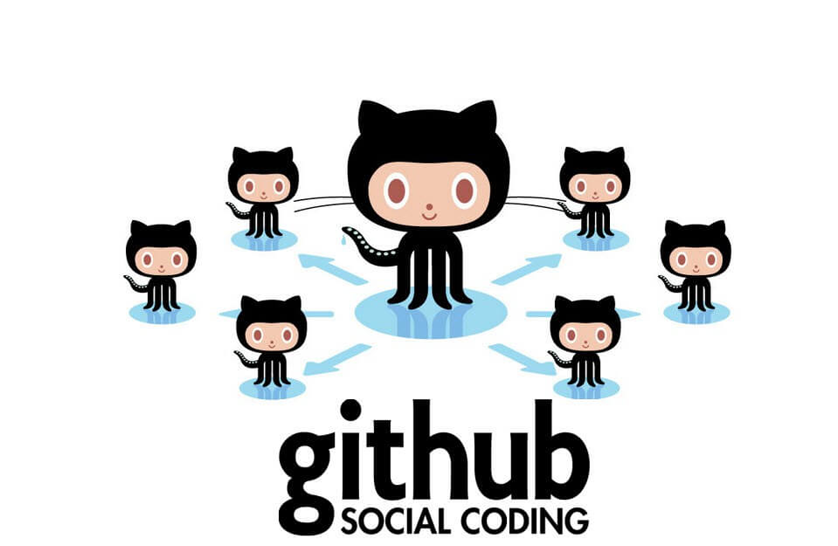
Benefits of github (cont.)
Github is a Repository
What this means that it allows your work to get out there in front of the public. Moreover, GitHub is one of the largest coding communities around right now, so it’s wide exposure for your project.
Track changes in your code across versions
When multiple people collaborate on a project, it’s hard to keep track revisions—who changed what, when, and where those files are stored. GitHub takes care of this problem by keeping track of all the changes that have been pushed to the repository. Much like using Microsoft Word or Google Drive, you can have a version history of your code so that previous versions are not lost with every iteration.
Integration Options
- Github can integrate with platforms like Eclipse, Spring Tool Suite, Intelli J, Slack, Microsoft Teams, Jira Cloud, and etc.

Slide 5
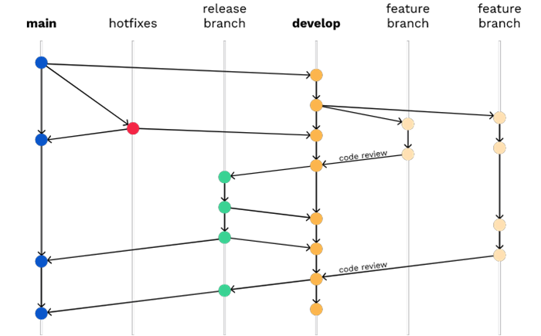
Branching Strategy

Slide 6
What is a branching strategy?
A “Branching Strategy” refers to the strategy a software development team employs when writing, merging, and shipping code in the context of a version control system like Git. Software developers working as a team on the same codebase must share their changes with each other.
The goal of any branching strategy is to problem solve and to enable teams to work together on the same source code without trampling on each other. A branching strategy defines how teams use branches to achieve this level of concurrent development
Why do you need a Branching Strategy?
. A branching strategy ensures everyone on the team is following the same process for making changes to source control. The right strategy enhances collaboration, efficiency, and accuracy in the software delivery process, while the wrong strategy (or no strategy) leads to hours of lost effort.

Slide 7
What is a branch strategy (cont.)
Common uses cases to consider developing a branch strategy
Typical Development Workflow - The typical day-to-day flow includes normal changes that developers make to the code, changes that do not bring any heightened sense of urgency. These changes are ordinary in terms of size and complexity for your codebase and, generally, will make up the bulk of all the changes your developers make. Since this flow will be used the most frequently, your strategy here must ensure proper coordination among the developers and support all relevant policies such as automated testing, pull requests, and deployments.
Emergency Hotfixes - An emergency hotfix is when a particular incident or issue has been expedited to deal with some emergent situation, normally bug fixes. Your flow must account for a developer who needs to make an urgent change and get it all the way through your process and into production while still aligning with your typical development workflow.
Small vs. Large Changes - As the industry has evolved, the emphasis on developers working on smaller changes and limited batch sizes has increased due to broader use of flow-based delivery practices. However, there are still times when you must make large, complex changes, and your branching strategy must accommodate those situations.
Standard vs. Experimental - Developers feel greater certainty about how standard code changes will perform than with experimental code changes. For example, if you’re evaluating a new library or framework, you may feel uncertain about how well it integrates with your codebase. In that case, your change may or may not actually go to production but still needs to be shared with other developers. Your branching strategy must account for these types of experimental changes.

Slide 8
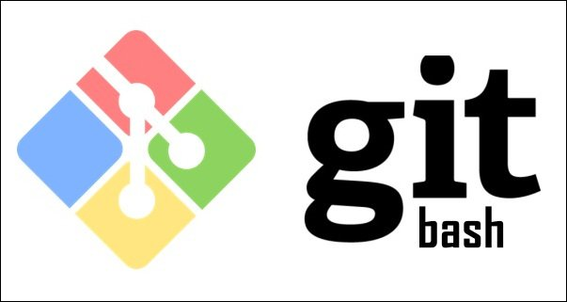
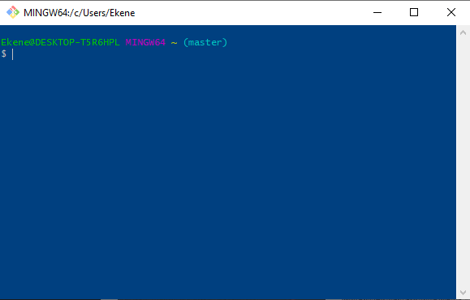
What is Git bash?
Git Bash is an application for Microsoft Windows environments which provides an emulation layer for a Git command line experience. Bash is an acronym for Bourne Again Shell. A shell is a terminal application used to interface with an operating system through written commands. Bash is a popular default shell on Linux and macOS. Git Bash is a package that installs Bash, some common bash utilities, and Git on a Windows operating system.

Slide 9
How to install git bash?
Here is a link that explains the installation steps on Git Bash for Windows users.
https://www.stanleyulili.com/git/how-to-install-git-bash-on-windows/
Here is a link that explains the installation of Git Bash for Mac users
https://phoenixnap.com/kb/install-git-on-mac

Slide 10
Git flow
Git flow is really just an abstract idea of a Git workflow. This means it dictates what kind of branches to set up and how to merge them together. The git flow init command is an extension of the default git init command and doesn't change anything in your repository other than creating branches for you.
GitFlow model: Some concepts
This model is based on assigning different roles to different branches inside the
repository. There are 4 types of branches in GitFlow:
Historical branches
Feature branches
Release branches
Maintenance branches
Every type of branch has a different meaning, and they are used for different things.
Historical branches
The Git-Flow workflow uses two branches to keep track of the history of your project. While the master branch holds the official release history, the develop branch servers as the branch for integrating features. Usually all commits in the master branch are taged with a proper version number. I suggest to follow the rules of Semantic Versioning.
You'll never work directly on one of these to branches. Your workflow works pretty much around these two branches.

Slide 11
Git flow (cont.)
Feature Branches
Each new feature is created in its own branch. Instead of branching off of master, features are branched of from develop. Whenever a feature is complete it gets merged back into develop. When creating new features, you should never work on master or develop directly
If you work on a project that already has an existing codebase in develop and you start working on a new feature, you have to create a new feature branch and branch off from develop. As long as you work on this feature, you'll work against this feature branch. This will allow you to easy switch back to the develop branch or stop working on a feature and start a new one without running into conflicts. Each feature should have a descriptive name like feature/career-api that help you and other developer to figure out what this feature branch is all about. Feature branches don't have to be pushed to the remote repository necessarily. After finishing the development of a feature, it need's to be merged back to develop. For a cleaner repository you should delete the feature branch afterwards locally as well as in the remote repository.
Feature workflow in a glimpse
1. Branch off development
2. Name feature branch feature/feature-name
3. Merge back into development
4. Delete feature branch

Slide 12
Git flow (cont.)
Release Branches
Once your develop branch hold enough features ready for a release you create a new release by fork a new release branch off of develop. The name of your new release branch follow the rules of Semantic Versioning (e.g. v0.1.0). When branching for a new release from develop you initialize a release cycle, so no new features can be added after this point — only bug fixes, documentation generation, and other release-oriented tasks should go in this branch. Once it's ready to ship, the release gets merged into master and tagged with a version number. In addition, it should be merged back into develop, which may has progressed with new features since the release was initiated. Creating dedicated branches for preparing releases enables on team to polish and prepare a release while the other team is continuing working on new features.
Release workflow in a glimpse
1. Branch of development
2. Name release branch release/v0.0.0
3. Tag release like v0.0.0
4. Merge back into master and develop
5. Delete release branch

Slide 13
Git flow (cont.)
Maintenance Branches
Fixing bugs and quickly patch production releases happens on Maintenance or hotfix branches. This is the only branch type that is allowed to directly branch off of master. Once a hotfix branch is made, it should be merged back to master and develop or the current release branch instantly. When merging a hotfix branch back to master it should be tagged with an updated version number (e.g. v0.1.1).
Hotfix workflow in a glimpse
1. Branch of master
2. Name of hotfix branch hotfix/xyz
3. Merge back into master, develop current release
4. Tag master with new number
5. Delete hotfix branch
Resources
1. Git Flow cheatsheet (also comes as a PDF)
2. Comparing workflows: Gitflow-workflow (Atlassian)
3. GitFlow (Atlassian)
4. A successful Git branching model

Slide 14
Git flow (cont.)
Trunk-based Development Workflow
In the trunk-based development model, all developers work on a single branch with open access to it. Often it’s simply the master branch. They commit code to it and run it. It’s super simple. In some cases, they create short-lived feature branches. Once code on their branch compiles and passess all tests, they merge it straight to master. It ensures that development is truly continuous and prevents developers from creating merge conflicts that are difficult to resolve.
When can trunk-based Development Work Best?
When you are just starting up
If you are working on your minimum viable product, then this style is perfect for you. It offers maximum development speed with minimum formality. Since there are no pull requests, developers can deliver new functionality at the speed of light. Just be sure to hire experienced programmers.
When you need to iterate quickly
Once you reached the first version of your product and you noticed that your customers want something different, then don’t think twice and use this style to pivot into a new direction. You are still in the exploration phase and you need to be able to change your product as fast as possible.
When you work mostly with senior developers
If your team consists mainly of senior developers, then you should trust them and let them do their job. This workflow gives them the autonomy that they need and enables them to wield their mastery of their profession. Just give them purpose (tasks to accomplish) and watch how your product grows.

Slide 15
Git flow (cont.)
When Can Trunk-based Development Cause Problems?
When you run an open-source project.
If you are running an open-source project, then Git flow is the better option. You need very strict control over changes and you can’t trust contributors. After all, anyone can contribute. Including online trolls.
When you have a lot of junior developers
If you hire mostly junior developers, then it’s a better idea to tightly control what they are doing. Strict pull requests will help them to to improve their skills and will find potential bugs more quickly.
When you have established product or manage large teams
If you already have a prosperous product or manage large teams at a huge enterprise, then Git flow might be a better idea. You want to have strict control over what is happening with a well-established product worth millions of dollars. Probably, application performance and load capabilities are the most important things. That kind of optimization requires very precise changes.

Slide 16
Git flow (cont.)
Git Flow Work Best?
When you run an open-source project
This style comes from the open-source world and it works best there. Since everyone can contribute, you want to have very strict access to all the changes. You want to be able to check every single line of code, because frankly you can’t trust people contributing. Usually, those are not commercial projects, so development speed is not a concern.
When you have a lot of junior developers
If you work mostly with junior developers, then you want to have a way to check their work closely. You can give them multiple hints on how to do things more efficiently and help them improve their skills faster. People who accept pull requests have strict control over recurring changes so they can prevent deteriorating code quality.
When you have an established product
This style also seems to play well when you already have a successful product. In such cases, the focus is usually on application performance and load capabilities. That kind of optimization requires very precise changes. Usually, time is not a constraint, so this style works well here. What’s more, large enterprises are a great fit for this style. They need to control every change closely, since they don’t want to break their multi-million dollar investment.

Slide 17
Git flow (cont.)
When Can Git Flow Cause Problems?
When you are just starting up
If you are just starting up, then Git flow is not for you. Chances are you want to create a minimal viable product quickly. Doing pull requests creates a huge bottleneck that slows the whole team down dramatically. You simply can’t afford it. The problem with Git flow is the fact that pull requests can take a lot of time. It’s just not possible to provide rapid development that way.
When you need to iterate quickly
Once you reach the first version of your product, you will most likely need to pivot it few times to meet your customers’ need. Again, multiple branches and pull requests reduce development speed dramatically and are not advised in such cases.
When you work mostly with senior developers
If your team consists mainly of senior developers who have worked with one another for a longer period of time, then you don’t really need the aforementioned pull request micromanagement. You trust your developers and know that they are professionals. Let them do their job and don’t slow them down with all the Git flow bureaucracy.

